Slide 1

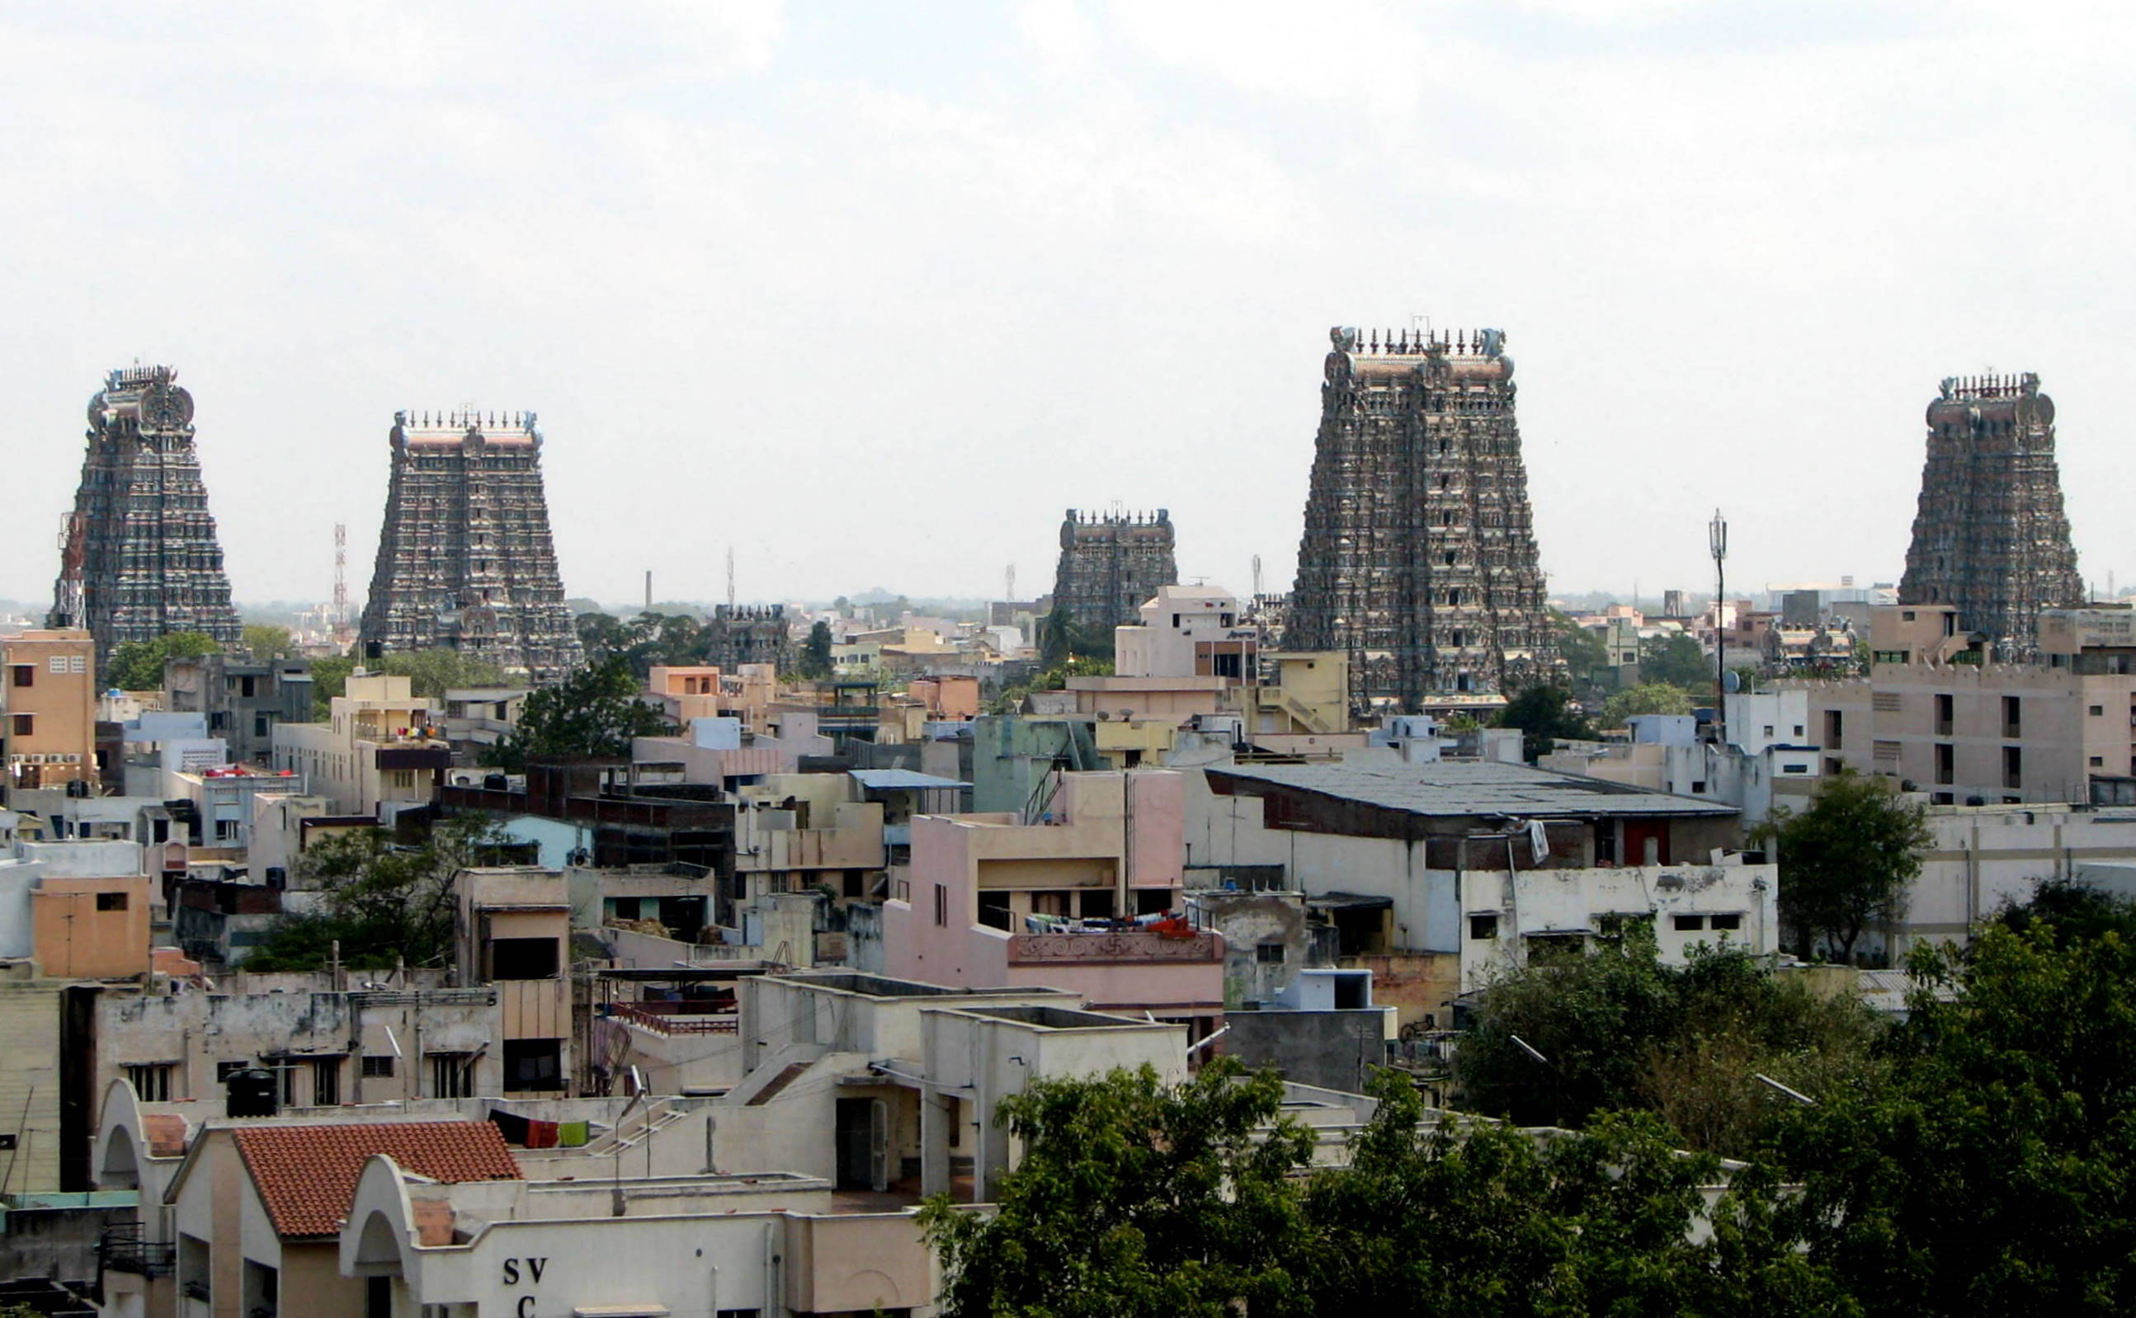
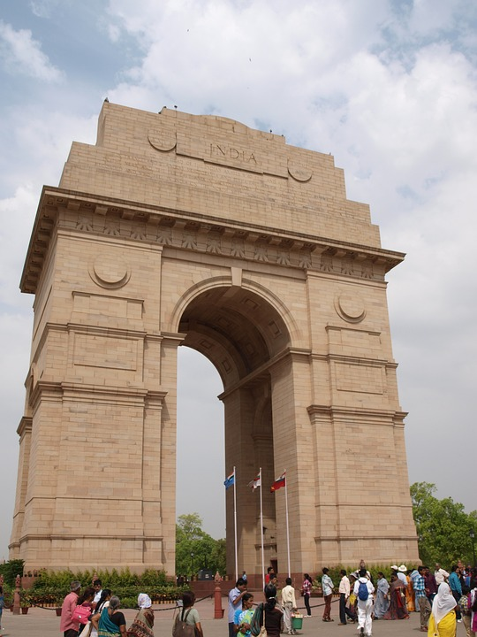
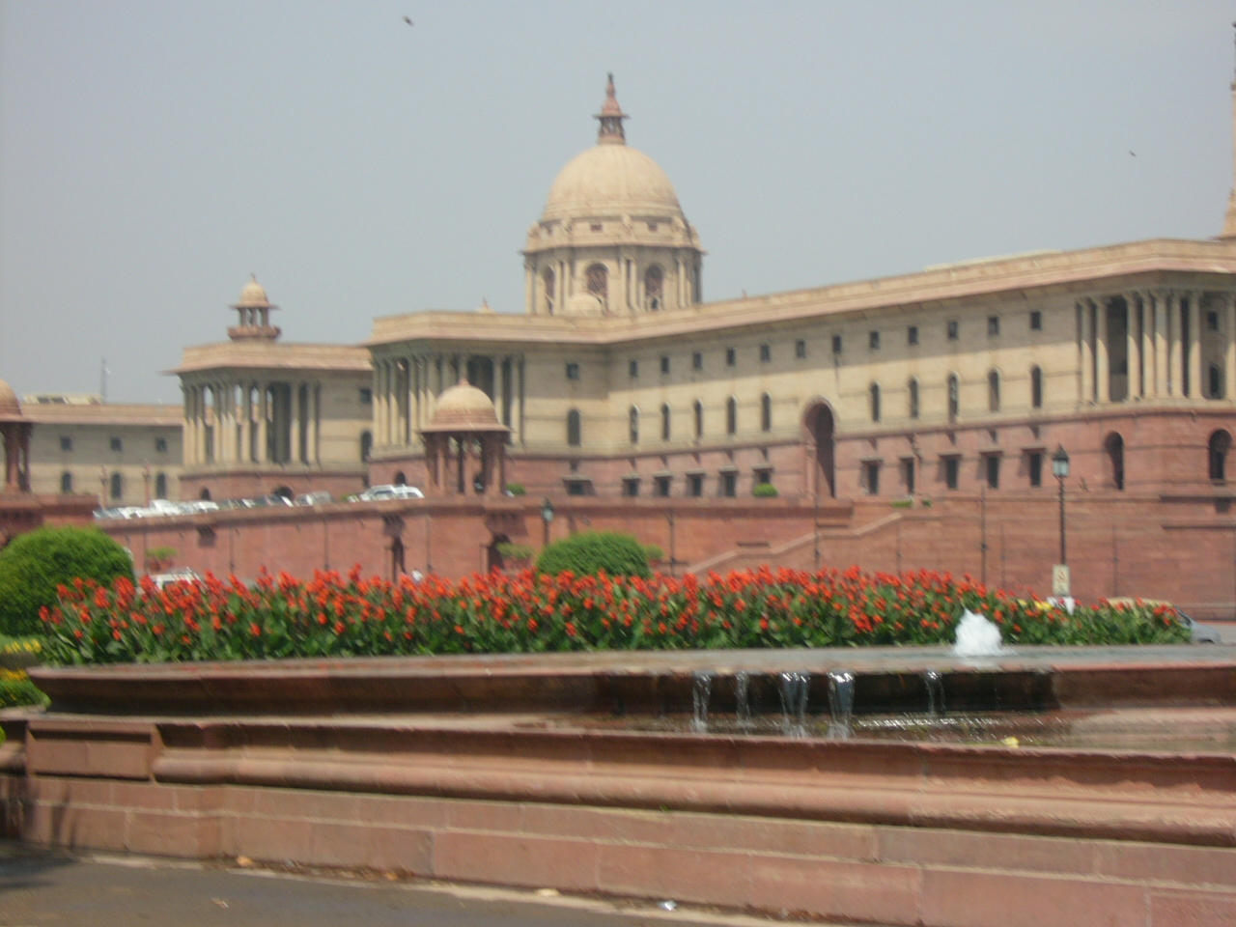
THE NEW ECONOMIC POLICY of INDIA (1991).
This Photo by Unknown author is licensed under CC BY-SA.
This Photo by Unknown author is licensed under CC BY-SA.

Slide 2


INTRODUCTION .
The Government of India introduced the New Economic Policy (NEP) in 1991 to respond to a balance of payments crisis. The NEP is credited to former Prime Minister Manmohan Singh as its architect. The NEP also emphasized implementing structural reforms to boost economic efficiency. It sought to enhance international competitiveness by removing rigidities across various economic sectors. The 1991 NEP was pivotal in reshaping India's economic landscape, ushering in significant transformations. The economic policy 1991 aimed at achieving multiple goals within India's economy. These objectives included:
Accumulating foreign exchange reserves.
Eliminating market restrictions.
Facilitating global trade of goods, services, capital, human resources, and technology.
Fueling economic growth.

Slide 3
Objectives Of New Economic Policy (NEP 1991)
The goal of the NEP 1991 was to reduce inflation rates and build up adequate foreign money reserves to increase its economic growth rate.
The major aim is to plunge the Indian Economy into the ‘globalization’ arena and provide it with a new direction in the market.
It aimed at economic stabilisation and a market economy by eliminating unnecessary regulations.
It urged private actors in all areas of the economy to expand their engagement. This is why the reserved government sector numbers have decreased.
Without limitations, it aimed to enable the worldwide movement of products, services, capital, people resources, and technology.

Slide 4



Features of New Economic Policy 1991
Macroeconomic stabilisation and structural changes were part of the reform programme.
Structural reforms are medium and long-term programmes that address sector adaptation and supply-side issues and bring vitality to the economy and competitiveness.
Macroeconomic stabilisation is a short-term macroeconomic crisis resolution programme that regulates overall economic demand.
Focus areas of the NEP 1991 Economic Reforms were Liberalisation, Privatization, and Globalisation also Financial Sector Reforms & Fiscal Policy reforms.
1. Liberalization:
Deregulation: Reduction of government controls on business activities, ending the "License Raj."
Industrial Policy: De-licensing of industries, except for a few strategic sectors.
Tax Reforms: Rationalization of tax structure and reduction in tax rates to encourage compliance and investment.
2. Privatization:
Disinvestment: Selling government stakes in public sector enterprises to raise funds and improve efficiency.

Slide 5



Public Sector Reforms: Restructuring public sector enterprises to make them more competitive and profitable.
3. Globalization:
Trade Policy Reforms: Reduction of import tariffs, removal of quantitative restrictions, and encouragement of exports.
Foreign Investment: Opening up sectors to Foreign Direct Investment (FDI) and easing regulations for foreign investors.
4. Financial Sector Reforms:
Banking Reforms: Deregulation of interest rates, entry of private banks, and strengthening of banking supervision.
Capital Market Reforms: Establishment of SEBI (Securities and Exchange Board of India) to regulate and develop the capital market, and liberalization of stock market operations.
5. Fiscal Policy Reforms:
Deficit Reduction: Measures to reduce the fiscal deficit through expenditure control and revenue enhancement.
Subsidy Reforms: Rationalization and targeting of subsidies to reduce fiscal burden.

Slide 6
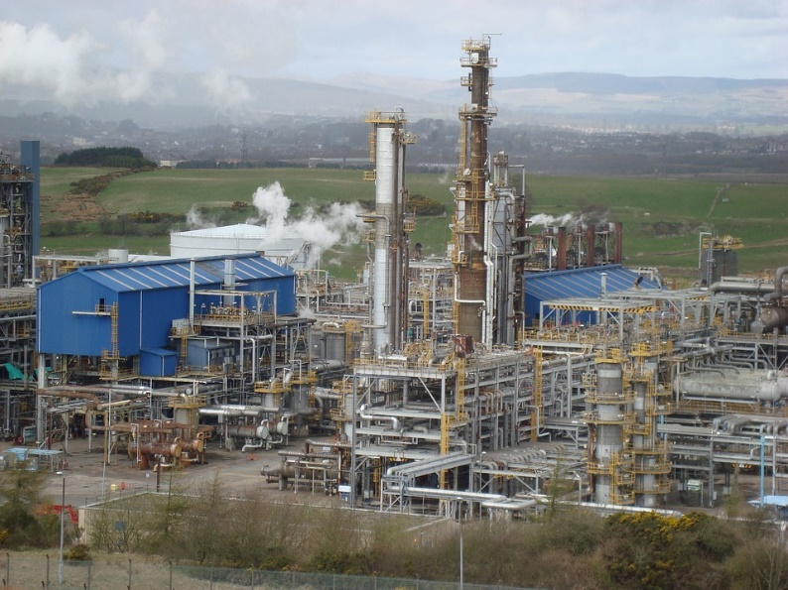

Impacts on Various Sectors
Industrial Sector:
Growth and Diversification: Rapid industrial growth due to increased competition and reduced bureaucratic hurdles.
Technological Upgradation: Adoption of new technologies and practices due to increased foreign investment and collaborations.
2. Services Sector:
Boom in IT and Services: Liberalization led to the growth of the IT and services sector, making India a global hub for IT services and BPO (Business Process Outsourcing).
Financial Services: Growth in banking, insurance, and capital markets due to financial sector reforms.
This Photo by Unknown Author is licensed under CC BY-NC

Slide 7

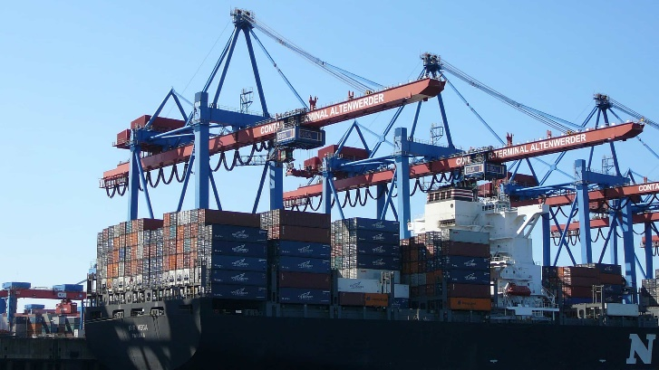

3. Agriculture Sector:
Mixed Results: While some reforms like reduced subsidies and exposure to global markets had mixed impacts, agricultural productivity saw improvements through better access to technology and inputs.
4. Trade and External Sector:
Export Growth: Significant increase in exports due to improved competitiveness and access to international markets.
FDI Inflows: Substantial increase in foreign direct investment, bringing in capital, technology, and management expertise.
5. Infrastructure:
Improvement: Increased private sector participation in infrastructure development, leading to better roads, telecommunications, and power sectors.

Slide 8

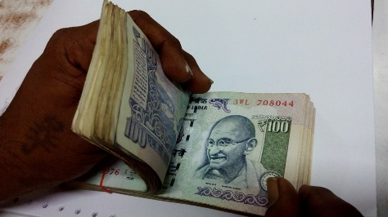

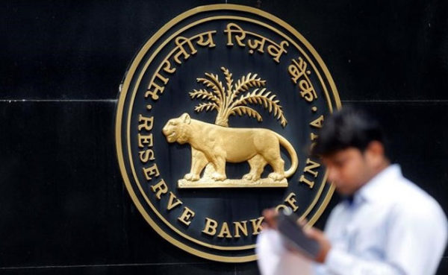
Impacts Shaping Post-Liberalization India
Sustained Economic Growth: India experienced higher and more sustained economic growth rates post-1991.
Increased Global Integration: The Indian economy became more integrated with the global economy, benefiting from trade and investment flows.
Improved Standard of Living: Higher economic growth translated into improved living standards, reduced poverty rates, and increased employment opportunities.
Challenges of Inequality: Economic liberalization also led to increased income inequality and regional disparities, posing a challenge for inclusive growth.
Institutional Development: Strengthening of institutions like SEBI, RBI, and regulatory frameworks contributed to a more robust economic environment.

Slide 9
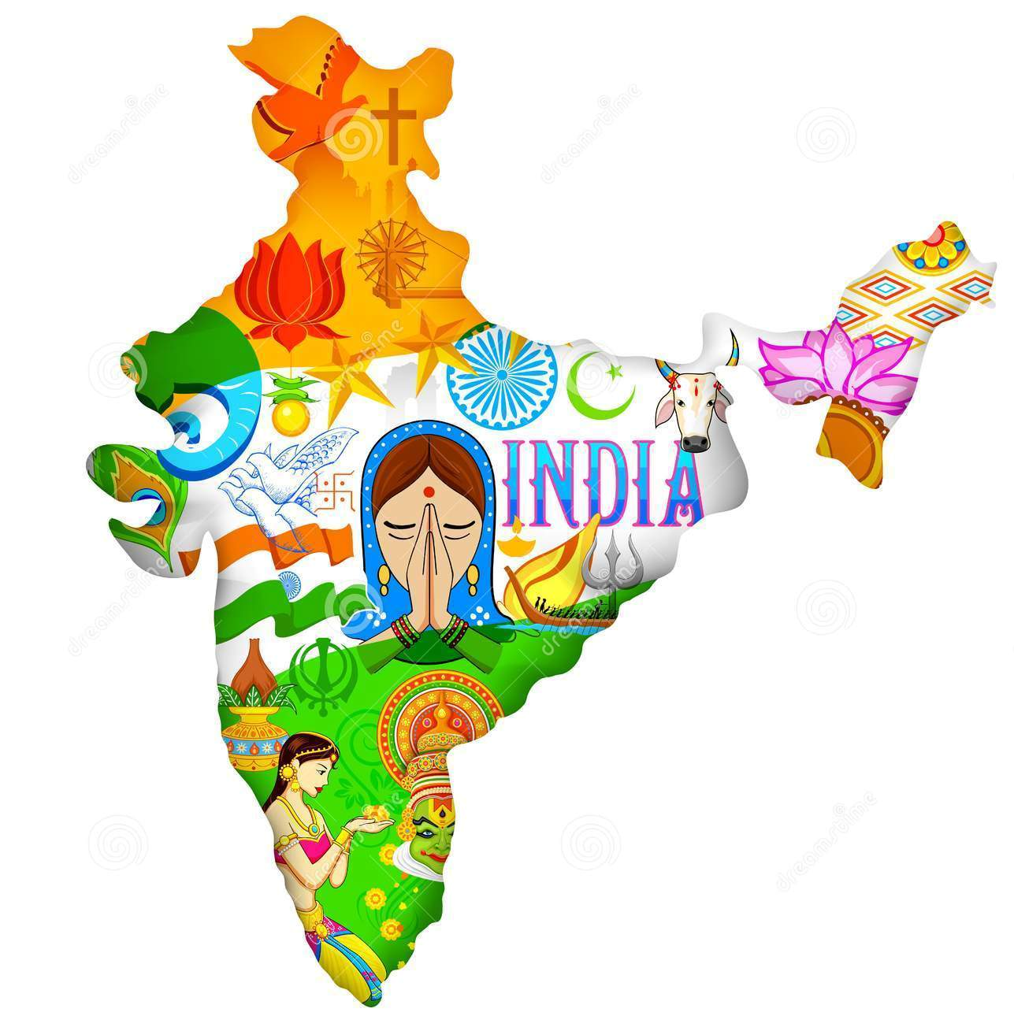
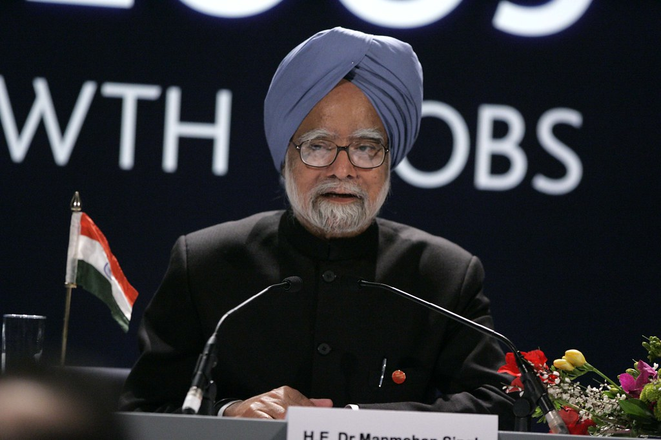

SUMMARY
In summary, the New Economic Policy of 1991 was a pivotal reform that transformed India's economy from a largely closed and controlled system to an open and market-driven one. The policy not only addressed immediate economic challenges but also laid the foundation for long-term growth and development, shaping India's path towards becoming one of the world's major economies.

Slide 10
THANK YOU PPT By- 635

